Slide 1
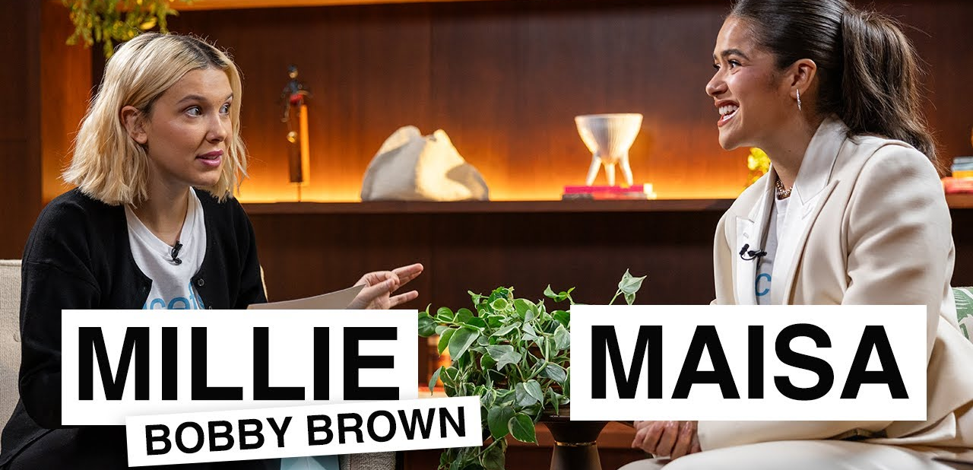
Maisa Interviews Millie Bobby
Brown
Teacher Lauren Stigliano
— Youth, Education & UNICEF Projects Main Skills: Listening, Speaking, Vocabulary, Grammar, Critical Thinking

Slide 2
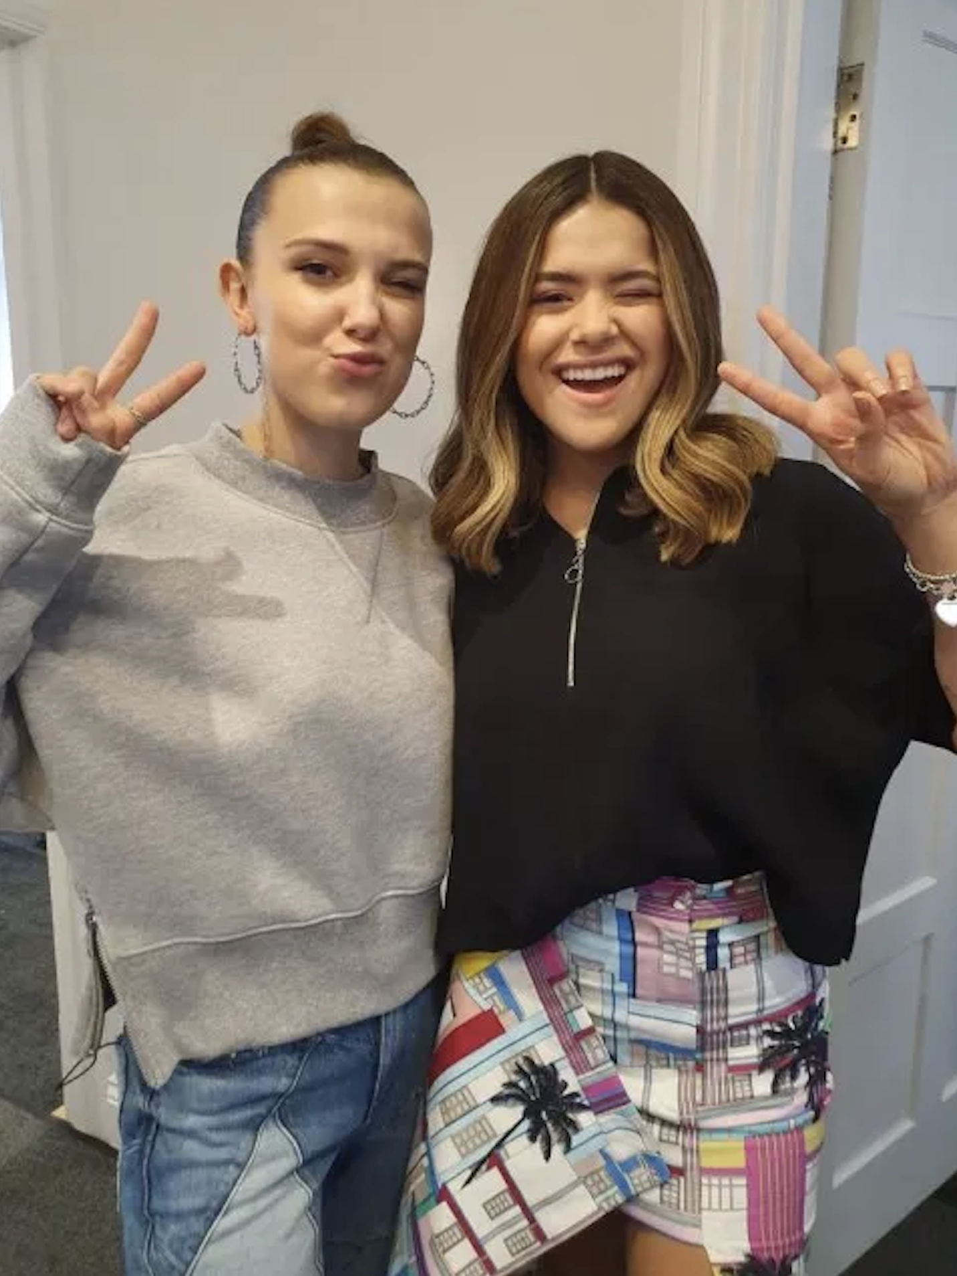
Warm-up & Introduction
Teacher Lauren Stigliano
Discussion Questions
Do you know who Millie Bobby Brown is? Where is she from?
Do you know Maisa? Why is she famous in Brazil?
Have you ever heard of UNICEF?
Do you think celebrities can make a real difference in the world? Why / Why not?

Slide 3
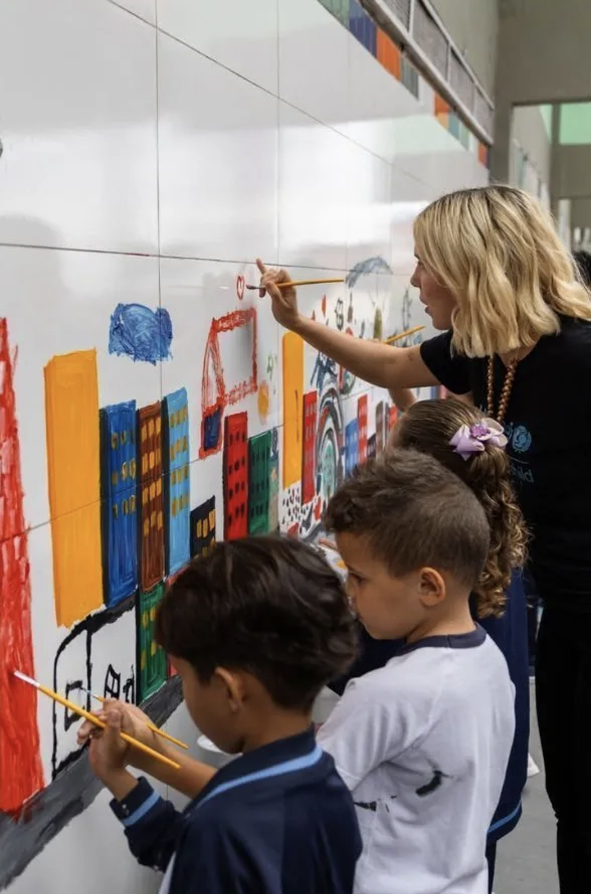
Pre-Listening
Teacher Lauren Stigliano
Prediction Task
What topics do you think they will talk about?
Why do you think they work with UNICEF?
What problems do you think UNICEF focuses on?
“I think they will talk about __________ because __________.”

Slide 4
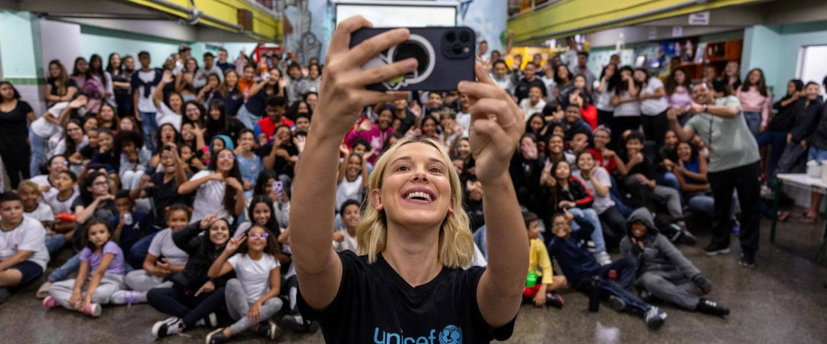
Vocabulary Preparation
Teacher Lauren Stigliano
B1
B2
C1
ambassador
education
opportunity
privilege
community
support
inspire
motivate
make a change
young people / youth
commitment
empower
initiative
platform
raise awareness
access to education
advocacy
menstrual hygiene
social inequality
marginalized communities

Slide 5
While-Listening
Teacher Lauren Stigliano
Task 1
Task 2
Who are the two speakers?
What organization are they working with?
What is the main topic of the conversation?
Why did Millie start working with UNICEF?
What personal experiences motivated her?
What UNICEF projects are mentioned?
Why is education so important to both speakers?

Slide 6
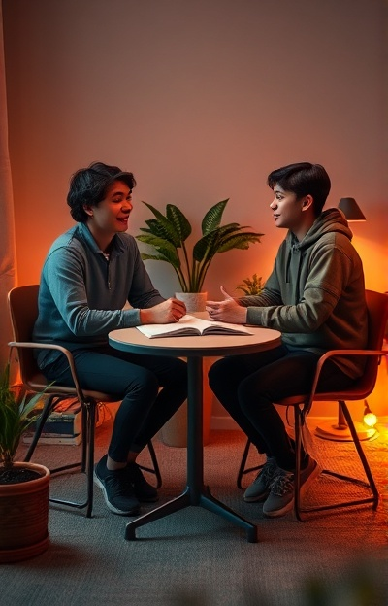
Grammar Focus
Teacher Lauren Stigliano
Notice and practice Present Perfect & Past Simple, used naturally in the interview.
Guided Practice
Focus Structures
Millie __________ (start / have started) working with UNICEF when she was 13.
She __________ (has spoken / spoke) about education many times.
UNICEF __________ (helped / has helped) young people around the world.
“I started when I was very young.”
“I have spoken at the UN many times.”
“UNICEF has helped many families.”

Slide 7
Discussion & Wrap-up
Teacher Lauren Stigliano
Reflection
Extra Practice
Final Challenge
More exercises for after class consolidation > MIRO
Imagine being a UNICEF ambassador and propose a project.
What did you learn today?
Which idea from the video was most interesting to you?
One new word you learned today.
Reflect on learnings and interesting ideas from the session.

